Slide 1

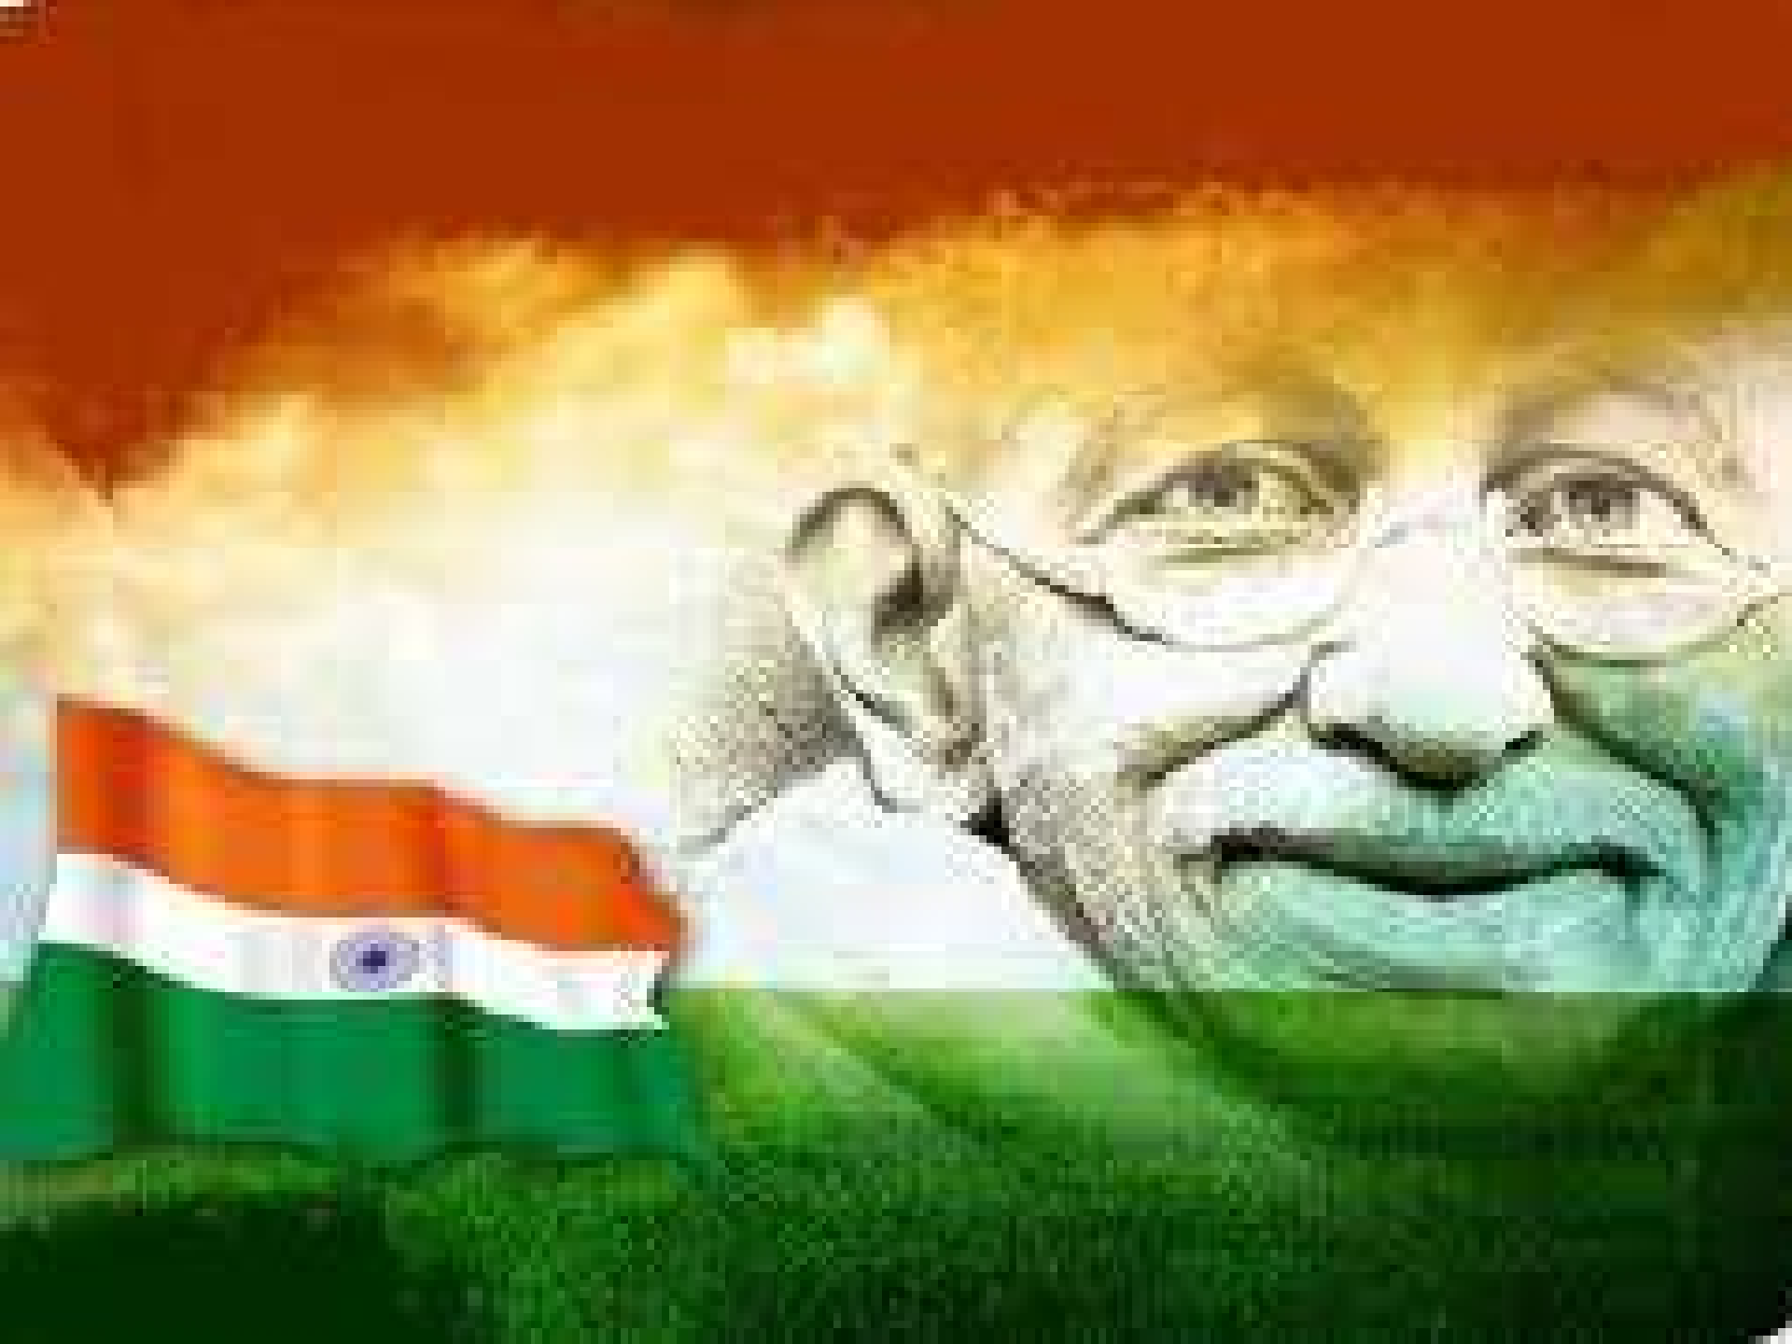



1

Slide 2


Slide 3
“All constitutions are the heirs of the past as well as the testators of the future……………”
- Jennings
On 26th January, 1950, the present Constitution of India was brought into force which announced to world the birth of a new republic.
The constitution of the Indian Republic is the product not of a political revolution, but of the research & deliberations of a body of eminent representatives of the people.
These people improve the existing system of administration, thus making constitutional development for a proper understanding.

Slide 4


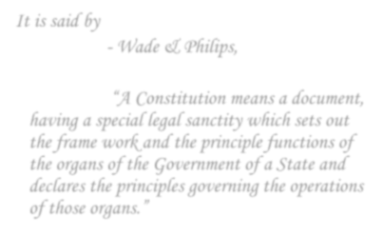

“A Constitution means a document, having a special legal sanctity which sets out the frame work and the principle functions of the organs of the Government of a State and declares the principles governing the operations of those organs.” - Wade & Philips,

Slide 5

It means the rule which regulates the structure of the principal organs of the Government and their relationship to another, and determines theirs principle functions.

Slide 6



It is, however not necessary to go to any period beyond what is known as the ‘British Period’ for modern political institutions originated & developed in that period only.
The institutions established by Hindus – Olden Days Muslims – Medieval Period have become a past, & they do not survive in any form in the present day.
The British Period in the history of India began with incorporation of “East India Company” in the year 1600 in England.
Now let us study the various phases of the growth of our constitution from the advent of the English on Indian shore till this day…

Slide 7


We can broadly divide the period as follows :-
1600 – 1765 :- The Coming of the British
1765 – 1858 :- Beginning of the British Rule
1858 – 1919 :- End of Company’s Rule
1919 – 1947 :- Introduction of Self Government
1947 – 1950 :- The Framing of the New
Constitution

Slide 8




The Government of India Act, 1858 :-
The Act of 1858 transferred Government of India from the Company to the British Crown.
India henceforth to be governed by and in the name of “Her Majesty”.
All the powers where in hands of Her Majesty’s Secretary of State.
The powers of the Crown were transferred or to exercised by the secretary of state for India
assisted by a council of 15 members.
The Essentials Features of the System introduced by Act of 1858 :-
The administration of the country was not only unitary but rigidly centralized. The provincial Governments were mere agents of the government of India and had to function under the superintendence, direction and control of the Governor – General .
There was no Separation of functions. All the Authority for governance of India - civil & military , executive & legislative was vested in the hands of Governor – General in Council.
The control of the Secretary of State over the Indian administration was absolute. The secretary has - superintendence, direction and controls of all acts related to the government of India.
The entire machinery of administration was bureaucratic, totally unconnected about public opinion in India.

Slide 9
The Indian Council’s Act, 1861 :-
The Indian Councils Act , 1861 was basic importance .
The Act enlarged the council of the Governor- General for the purpose of making laws and regulations by the additions of not less than 6 and not more than 12 ‘ Additional Members’ : half of these were to be non- officials members.
This Act suffered from many defects. It gave unlimited power to the governor – general rather than people.
The Indian Council ‘s Act, 1892 :-
This Act achieved three things : -
It increased the number of members in the Central and Provincial Council
Introduced the election systems partially, and
Enlarged the functions of the Council.
It is true that the Act laid down the foundation of the representative Government but it also suffered from many defects. 1st defect- that the system of election was defective.
2nd defect – the power of Legislative Councils were very limited.
3rd defect – the number of non-official members was very small.

Slide 10
The Morley – Minto Reform & The Indian Council Act, 1909 :-
The first attempt at introducing a representative and popular element was made by Morley – Minto Reforms knows by names of the Secretary of State (Lord Morley) & Viceroy Lord Minto which implemented by the Indians Council Act, 1909.
By this Act the size of Legislative Councils , Central as well as Provincial was considerably increased. The powers where also enlarged.
The council had also the right of discussing & moving a resolution on the financial statement but they were not given the power of voting.

Slide 11


Montagu – Chelmsford Report :- The landmark report in constitutional
development which led to enactment of the Government of India Act, 1919.
Main Features of Act, 1919 :-
The Declaration – promised for responsible government to India.
Dyarchy in the Provinces – Double Rule. It s objects was to train the natives
in the act of Self-Government.
Central Government – It was responsible to British parliament through the Secretary of State. It has bicameral legislative.
Structure of Government to remain unitary – Central Legislative had power to legislative on any matter. Government of India remained unitary and centralized government with the Governor General-in-Council as the key stone of constitution.
Shortcoming of Act, 1919 – Reforms of 1919, failed to fulfill aspirations of the people of India. Its reasons where -
1st non fulfillment of the demands for responsible Government.
2nd the failure of Dyarchy.

Slide 12
Simon Commission :-
British Government appointed a Statutory Commission known as Simon Commission.
This commission was constituted for 10 yrs. The commission was headed by Sir John Simon.
After 10 yrs completion Simon submitted his report in 1930. The Report was considered by a Round Table Conference consisting of the British Government & British India as well as of the Rulers of Indian states was to unite the Indian States with the rest of India under a federal scheme.
The Government of India Act, 1935 :-
This Act regarded as the full milestone on the highway leading to full responsible government. The basic features of the Act were –
federation & provincial autonomy
Dyarchy at the Centre
A bicameral central legislative created
Distribution of powers between center and provinces.

Slide 13
Cripps Mission :-
Cripps Mission came in 1942 & recognized the demand that..
a constitution to be framed by an elected constituent assembly.
Indian to be given a dominion status.
Cripps proposal were rejected. The labour party came into power in England. The Labour Govt. was more sympathetic towards India and wanted to solve the Indian problem with this end in view the cabinet mission was send to India.
Cabinet Mission, 1946 – Formation of Constituent Assembly :-
The cabinet Mission came into India on 4th March 1946. It consisted of 3 British members – Lord Pethic Lawrence, Sir Stafford Cripps, Mr. Alexander.
The Cabinet Mission provided for an indirectly elected constituent assembly.
The Assembly consisted of total 389 members. From which – 292 to be elected from Provinces, 93 to be nominated from princely states, 4 to be nominated from chief common areas.

Slide 14
Joint Constituent Assembly for India & Pakistan :-
The 1st meeting of the constituent assembly was held on Dec 9, 1946.
But it was boycotted was Muslim League.
Muslim League demanded a separate assembly for Pakistan.
On 26th July 1947 – Governor General Lord Mountbatten announced the setting of a separate constituent assembly for Pakistan.
Indian Independence Act, 1947 ( Mountbatten Plan) :-
Creation of 2 Independent Dominions i.e. India & Pakistan from 15th August 1947.
Dominions to Have Governor – General appointed by King.
Constituent Assemblies were empowered to frame laws.
After 15th August 1947 – No control of British Government on Dominion of the provinces.
Till New Constitutions came into existence - Dominions & the provinces
were governed by Government India Act, 1935.
Post of Secretary – abolished – taken over by Secretary of Common Wealth of Nation.
`
1947.
So , Indian Independence Act, 1947 came into force on 15th August
14

Slide 15




The struggle for independence was thus over by 15th August 1947. But the attainment of independence was not an end itself.
The 1st tasks undertaken by independent India was framing of New
Constitution.
The 1st meeting of the assembly was held on 9th Dec 1946 as the sovereign Constituent Assembly for India. On 11th Dec , Dr. Rajendra Prasad was elected as permant Chairman.
The Draft constitution was publish in Jan, 1948. The people of India were given 8 months to discuss the Draft & propose amendments.
The Draft constitution was considered for 114 days.
The New Constitution of India was adopted by the constituent assembly on 26th Nov 1949 & signed by the President Dr. Rajendra Prasad.
Some of new provisions of constitution, where came into force on 26th Jan
1950 & this was the date on which constitution was commenced.
15

Slide 16


The Indian Constitution is criticized to be borrowed from the number of other constitutions.
But it doesn’t mean that all the provisions are borrowed and implemented……
It has gone through a great amount of research on and above the borrowings from the other constitutions, to make the present Indian constitution.
These valuable inputs are largely influenced by factors like, Social, Economic & Geographical factors……
And hence, the Indian Constitution came into force after a huge period.
16

Slide 17
Thank You
17

